Slide 1
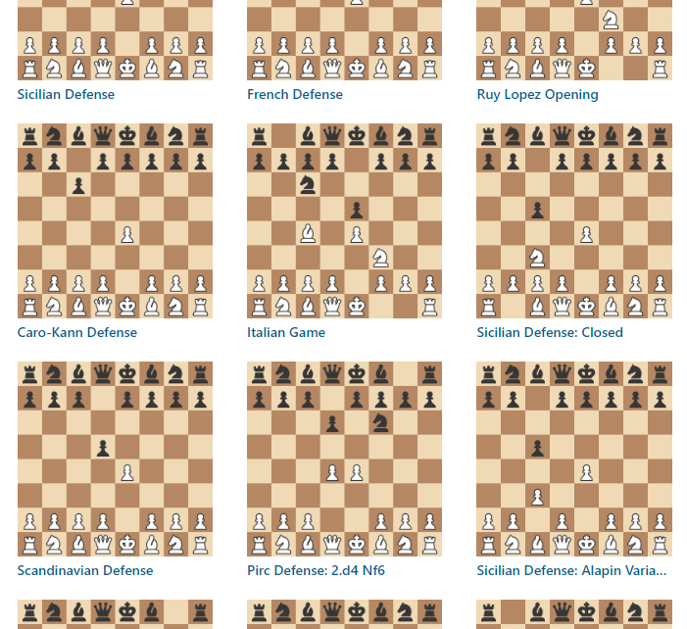
Chess Opening Analyzer
Adrian Obermühlner, Freja Rasmussen

Slide 2
Motivation
To create an application which analysis your chess games, and displays on a dashboard your opening weaknesses and strengths.

Slide 3
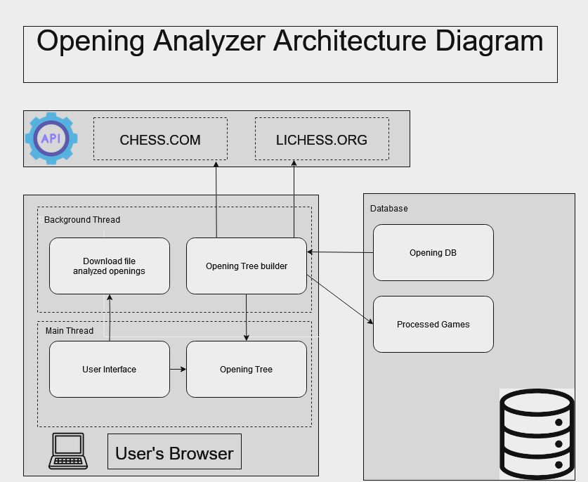
Architecture Diagram

Slide 4
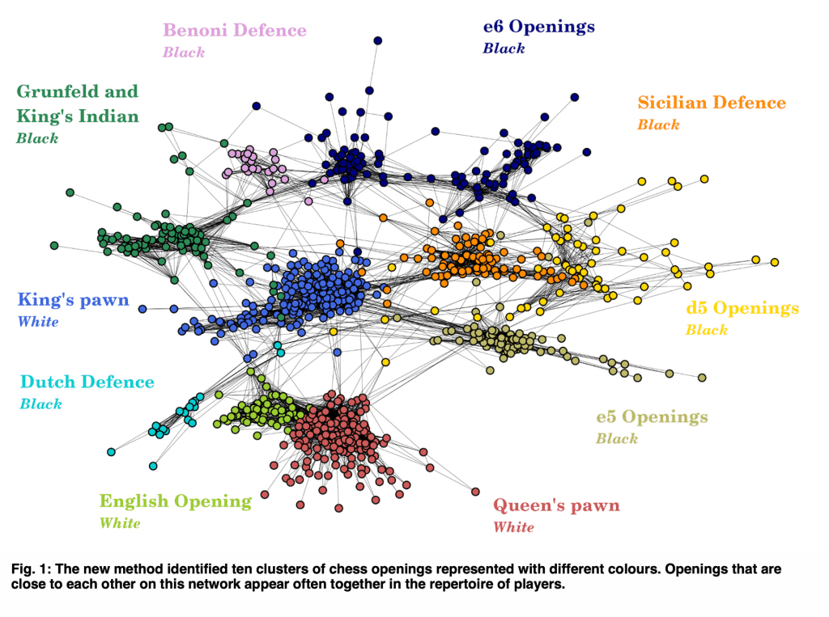
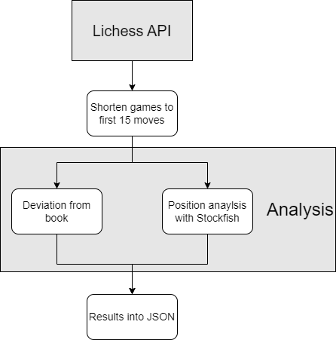
Challenges
Definition Chess Opening:
”A chess opening is the series of initial moves in a chess game, aimed at developing pieces, controlling the board's center, and ensuring the king's safety.”

Slide 5
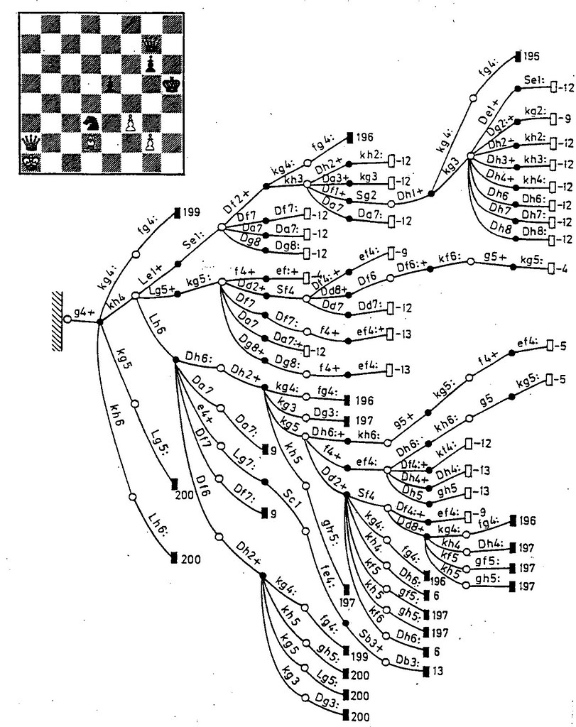
Challenges

Slide 6
Challenges
Example: 1 Player with 5000 games
Stockfish time to calculate 1 position with 2800 strength: 0.05s
We only analyze the first 15 moves.
5000 games * 15 moves * 0.05s = 3750s = 62min

